Slide 1


Diyala university
College of engineering
Department of computer engineering
First stage
Computer since
3-computer system component
Presented By
Abdullah Thaier Abdalsatir Al-obidy

Slide 2
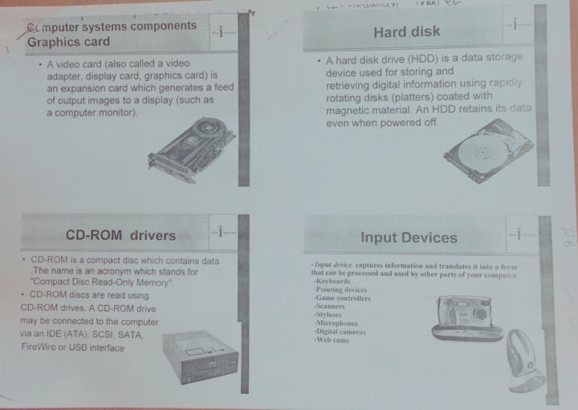
Overview
1. Inside a PC
2. The Motherboard
3. RAM
4. ROM
5. CMOS Memory
6. The CPU
7. Expansion Slots
8. Booting the Computer
the 'brains'
types of memory
the processor

Slide 3
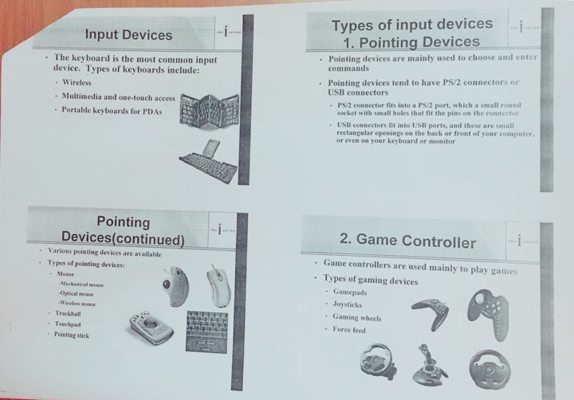
1. Inside a PC
CD-ROM
drive
Power
supply
Hard disk
drive
Mother
board
Floppy
disk drive
Sound/network
cards
Wires and
ribbon cables

Slide 4
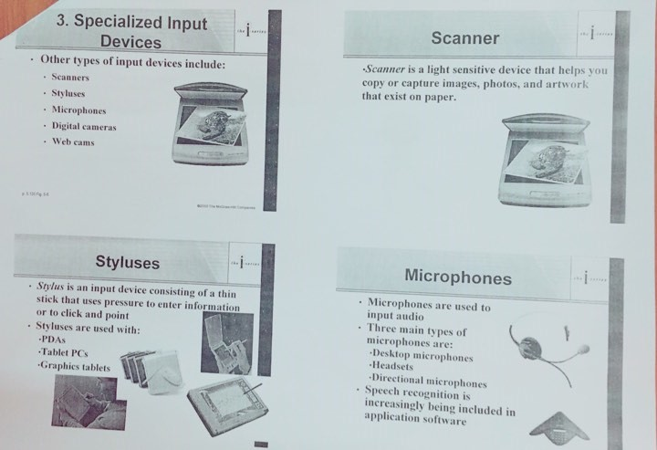

Slide 5
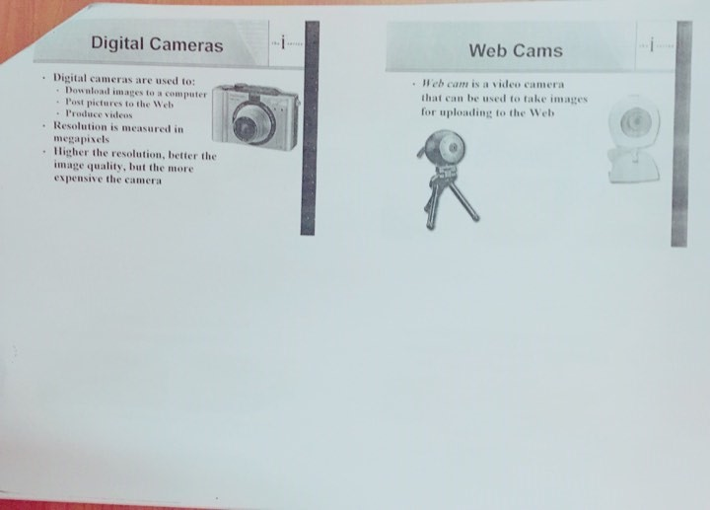
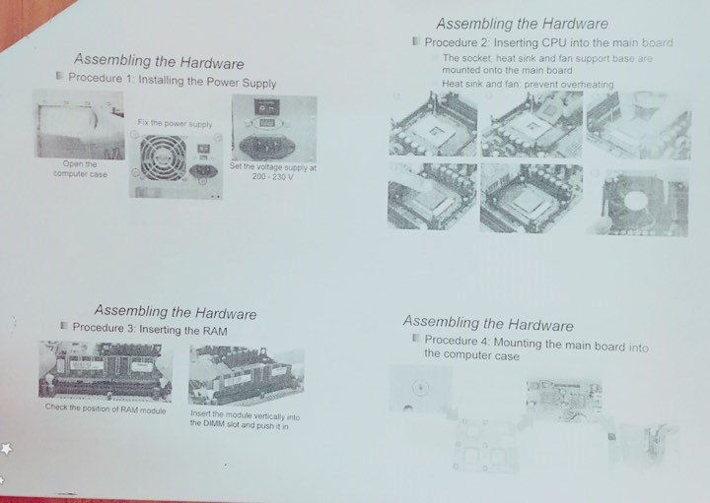
A Chip
A chip (microchip) is an integrated circuit - a thin slice of silicon crystal packed with microscopic circuit elements
  e.g. wires, transistors,
  capacitors, resistors

Slide 6
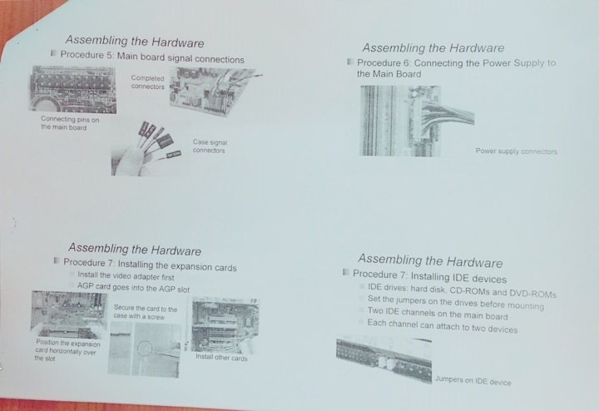
Motherboard Picture
Random Access
Memory (RAM)
chips.
Read-only
Memory
(ROM)
chips
Expansion slots
Processor chip
(the CPU)

Slide 7
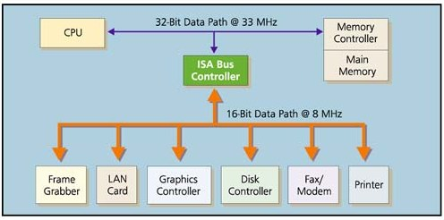
Moving Data
A data bus (a data path): connects the parts of the motherboard.
RAM
via expansion cards

Slide 8
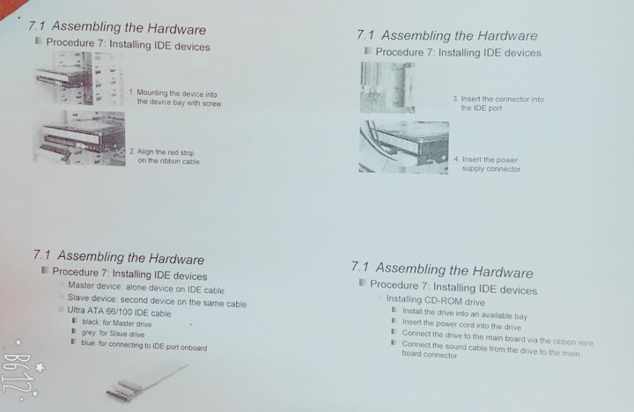
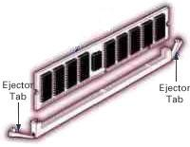
3. RAM
Random Access Memory (RAM).
RAM is used to hold programs while they are being executed, and data while it is being processed.
RAM is volatile, meaning that information written to RAM will disappear when the computer is turned off.
continued

Slide 9
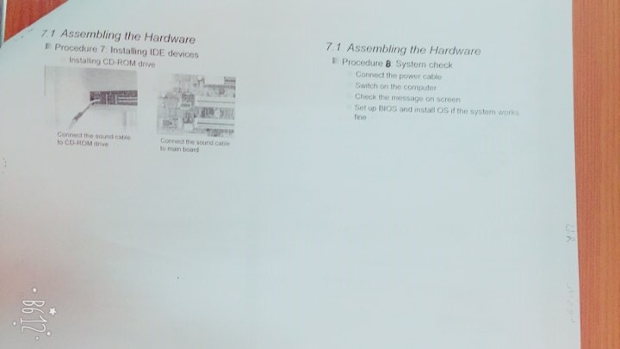
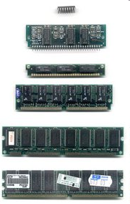
RAM contents can be accessed
in any (i.e. random) order.
By contrast, a sequential memory device, such as magnetic tape, forces the computer to access data in a fixed order because of the mechanical movement of the tape.

